Slide 1
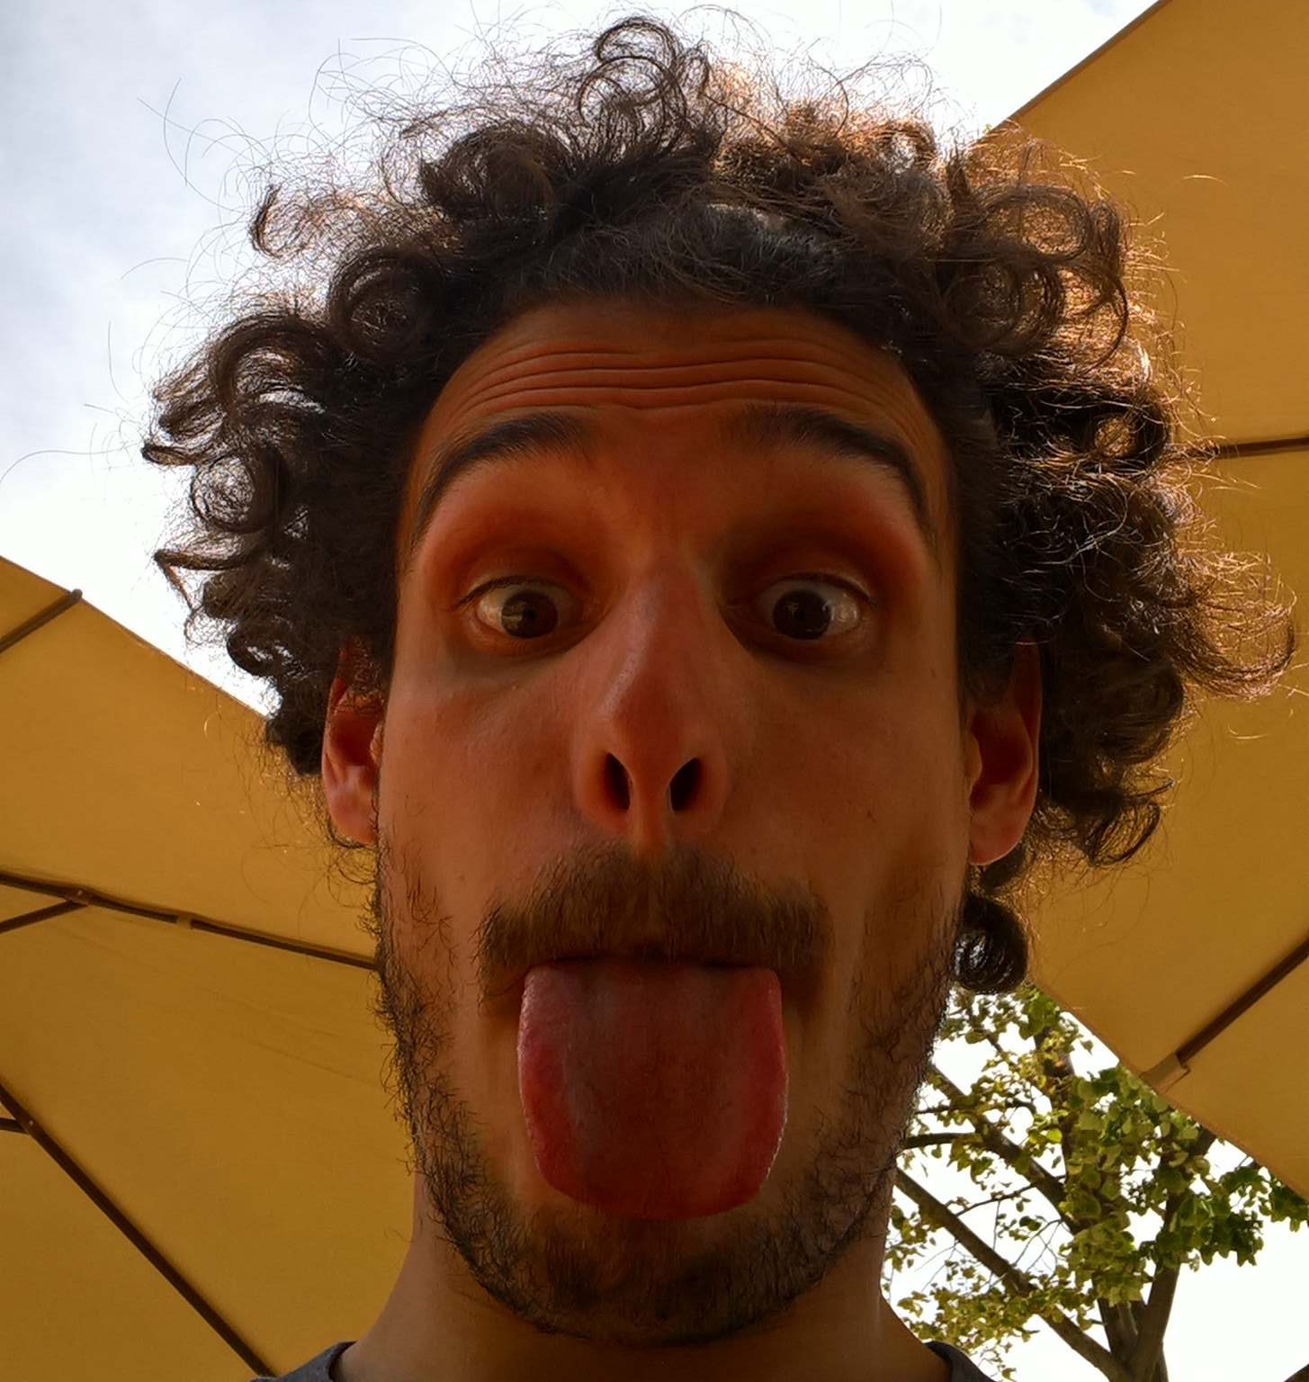

A scientist’s life
From Greek,
to energy saving,
to photochemistry,
to electrochemistry…
and so on!
(Dr.) Federico Dattila
@FedeDat

Slide 2
Interactive presentation
Feel free to ask while I am presenting!
Whenever you see the Quiz sign, get ready to answer! Raise your hand when ready!
Q

Slide 3
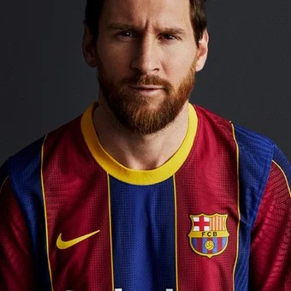

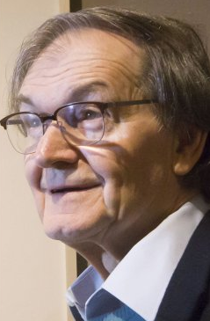
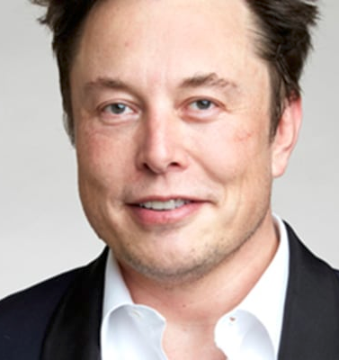
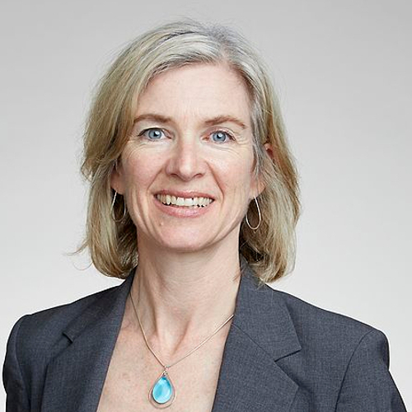
Q1
1
2
Lionel Messi, football player
Chiara Ferragni, influencer, entrepreneur
3
4
5
Roger Penrose, Nobel 2020
Elon Musk, entrepreneur
Jennifer Doudna, Nobel 2020

Slide 5

2008-2012, Italy
Humanities at the high school

Slide 6
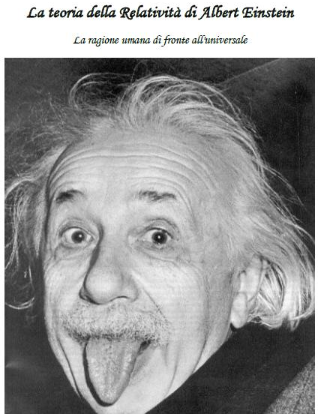
2012, High school thesis
The Theory of Relativity from
Albert Einstein
The human rational facing the universe
Quite an unexpected end!

Slide 7
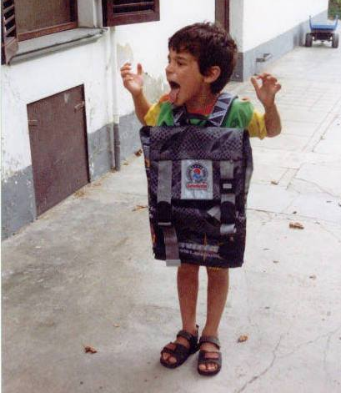
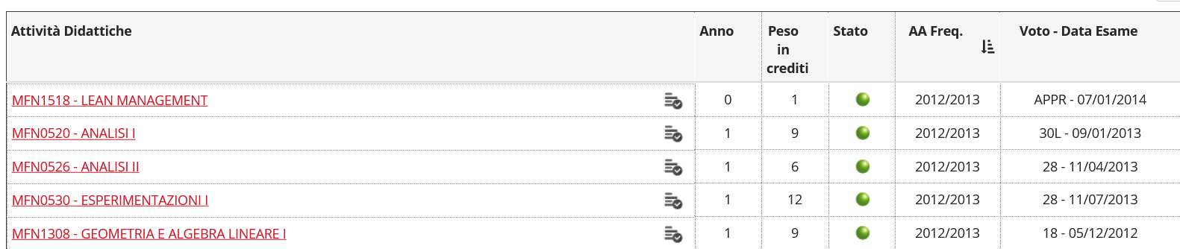
September 2012: Master in Physics!
Quite a terrible start!

Slide 8
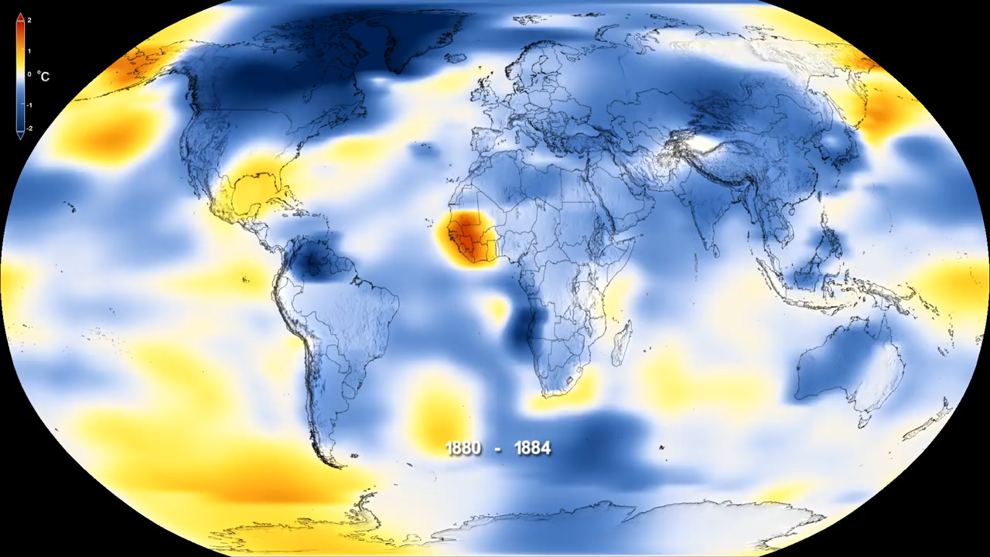
Climate change does not exist
NASA Climate Change: https://www.youtube.com/watch?v=gXXOkhoki8s

Slide 9
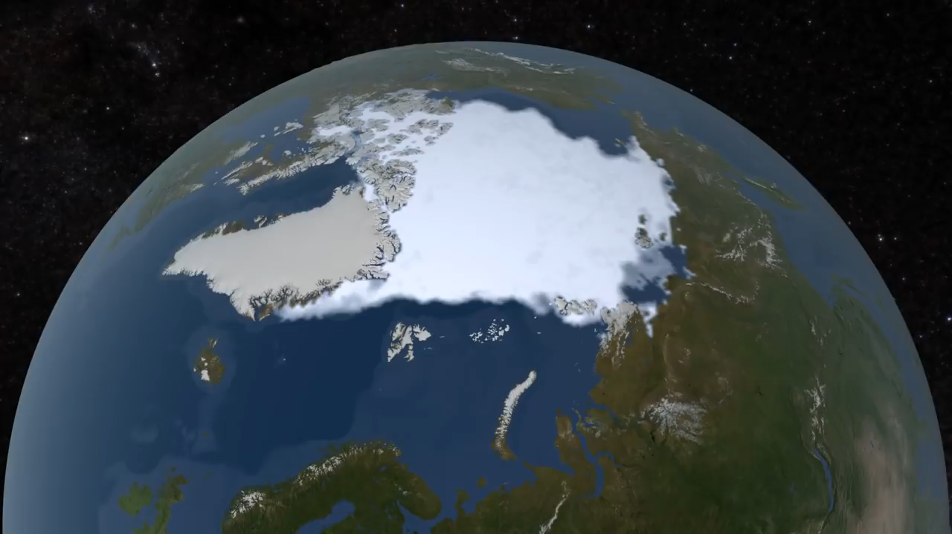
If you still have doubt…
NASA Climate Change: https://www.youtube.com/watch?v=Ymph_i6VWbM

Slide 10
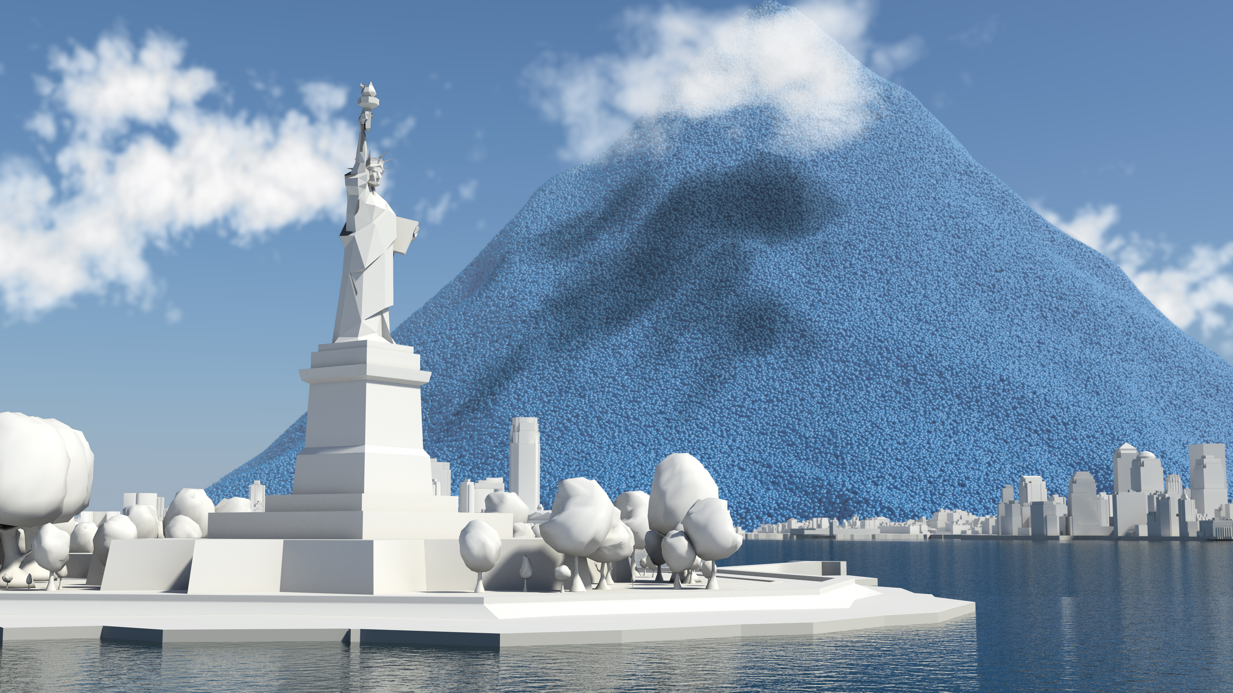
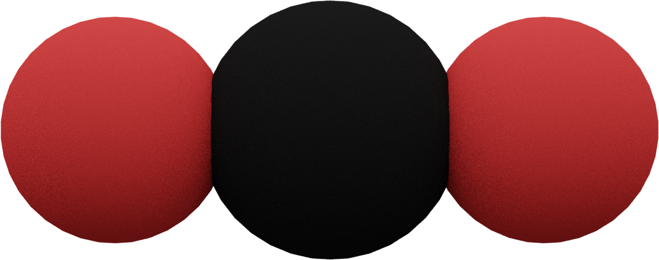
Daily global CO₂ emissions
www.carbonvisuals.com

Slide 11
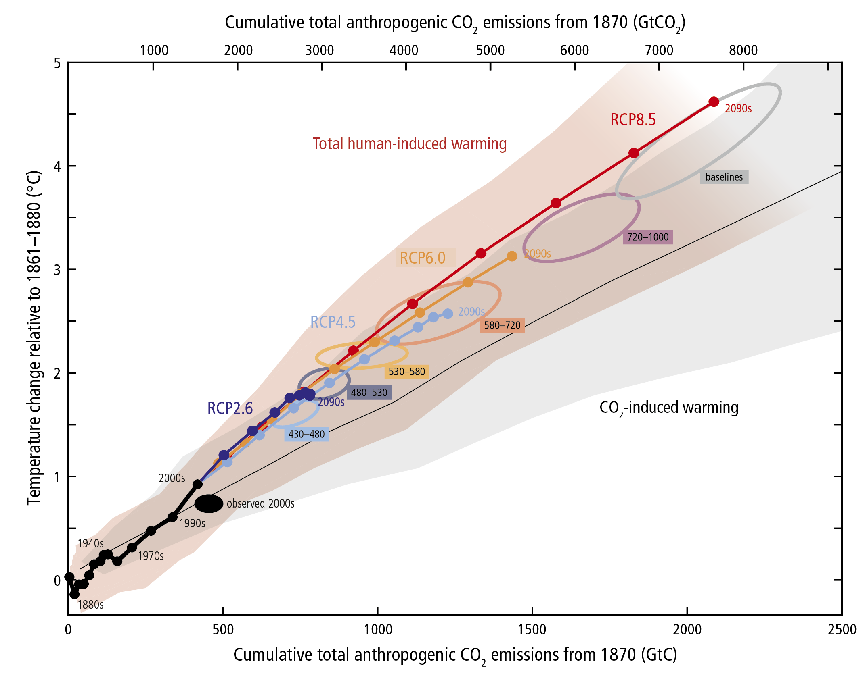
Why is CO₂ so important?

Slide 12
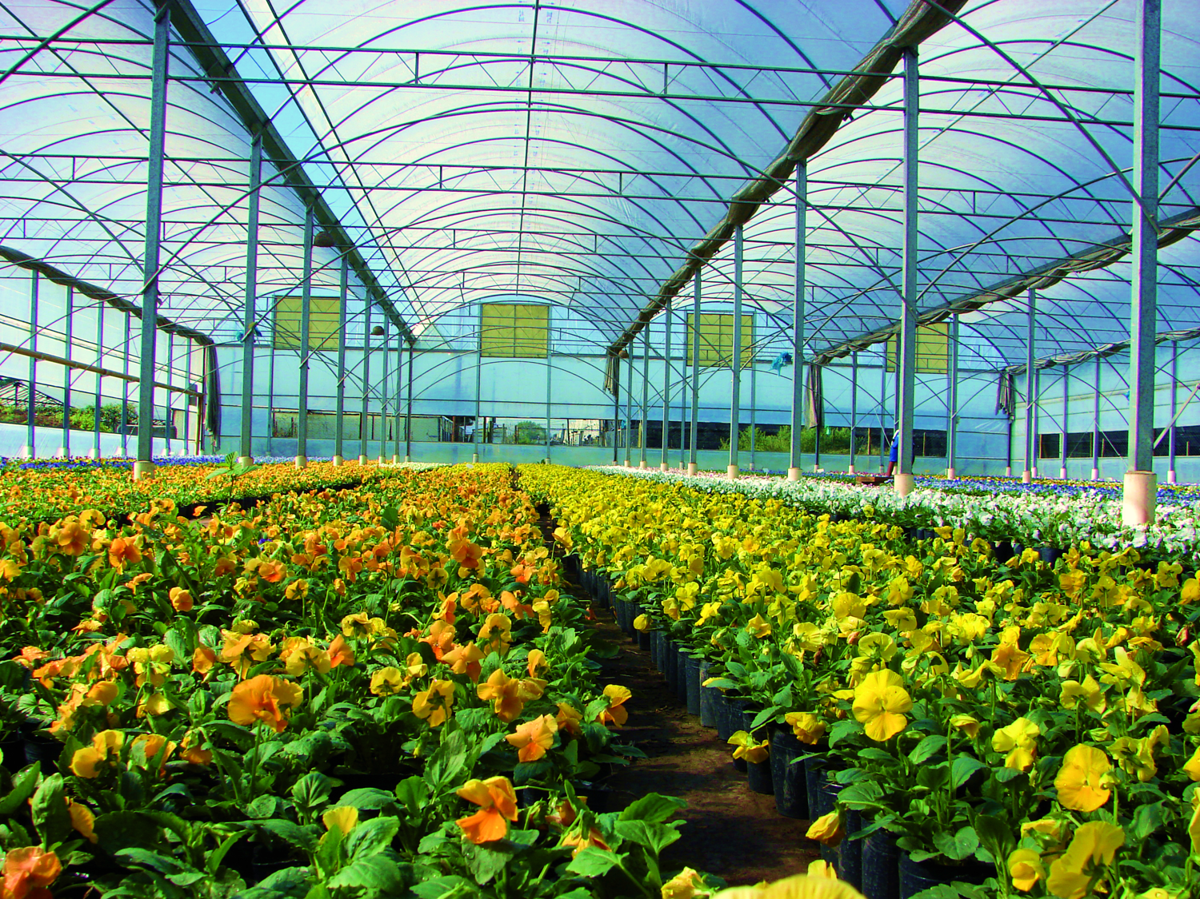
What is the greehouse effect?
Notes:
12

Slide 13
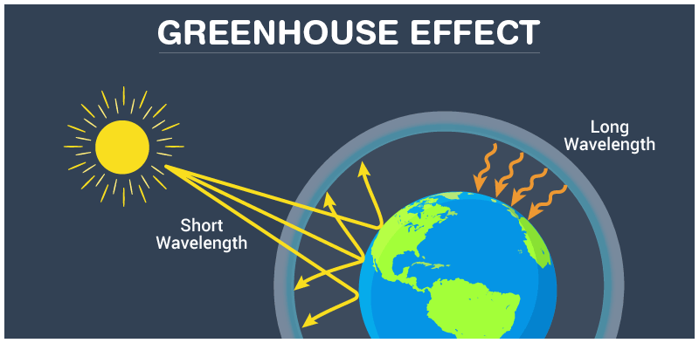
Notes:
13

Slide 14
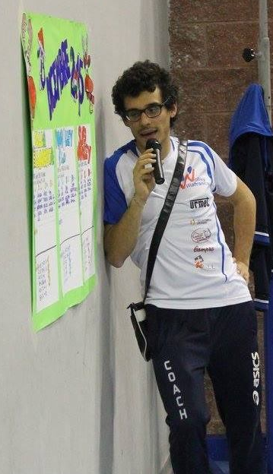
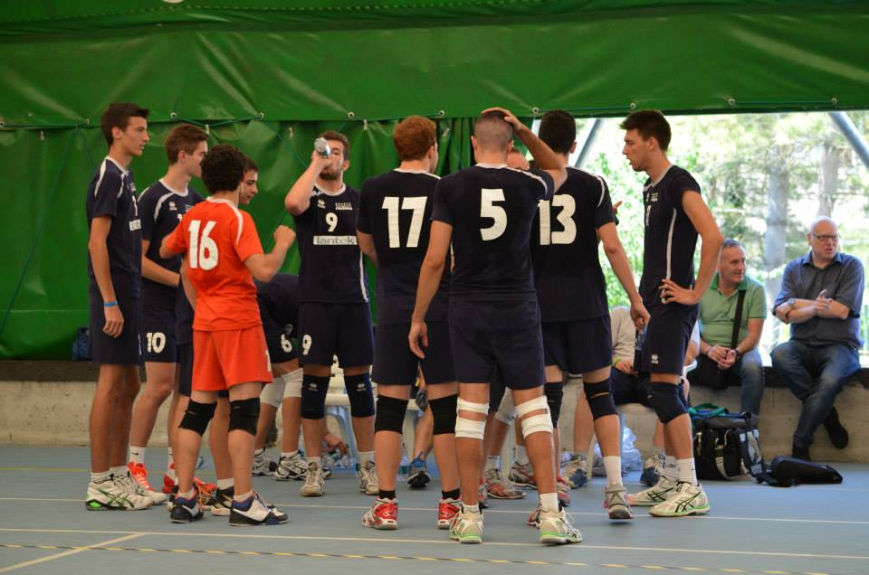
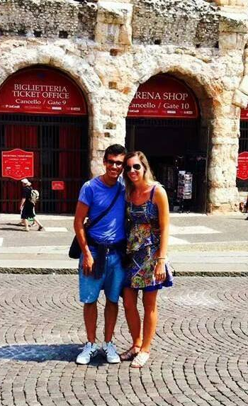
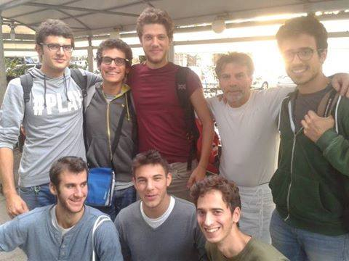
Just a teenager, so what’s next?

Slide 15
3rd year Bachelor in Physics…
What would you do?
Q3

Slide 16
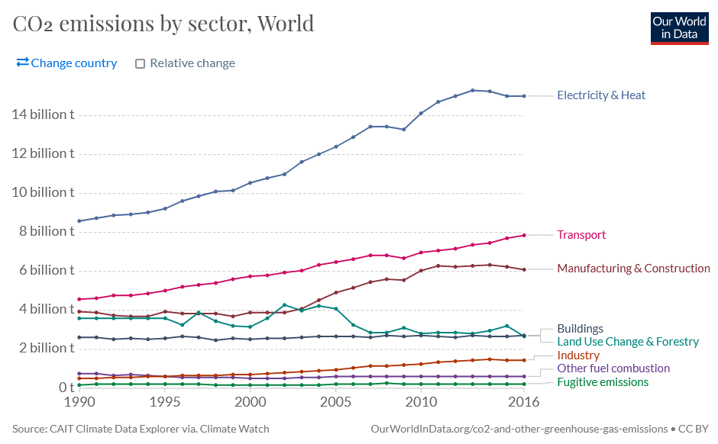
CO₂ emission by sector
https://ourworldindata.org/grapher/co-emissions-by-sector?country=~OWID_WRL

Slide 17

Do we need energy?
World energetic consumption
5 10²⁰ J in 2012
8 10²⁰ J in 2040
5 beers a day
50 years (20-70)
91250 ~ 1 10⁵ beers

Slide 18
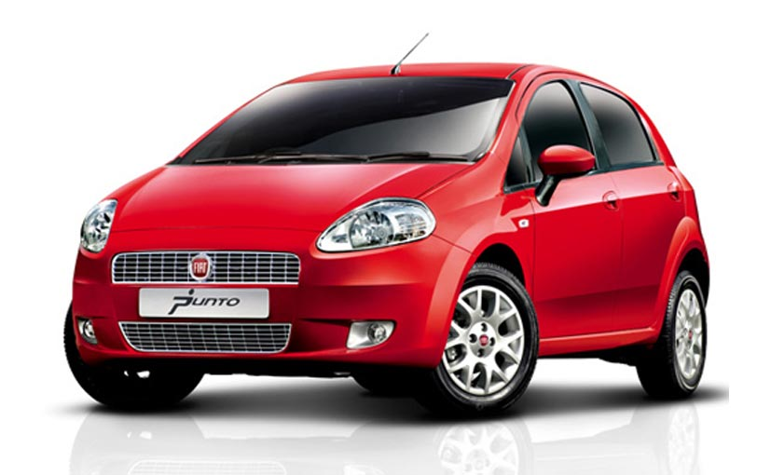
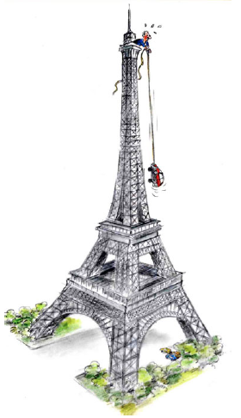
What is energy?
1 Wh = 3600 J
1 kWh (1000 Wh):
Pull a car on top of the Tour Eiffel (324 m)
Emission of 370 g of CO₂
(source ENDESA/MITECO)
Weekly absorption of a tree (source AQUAe Fundación)
Q4

Slide 19
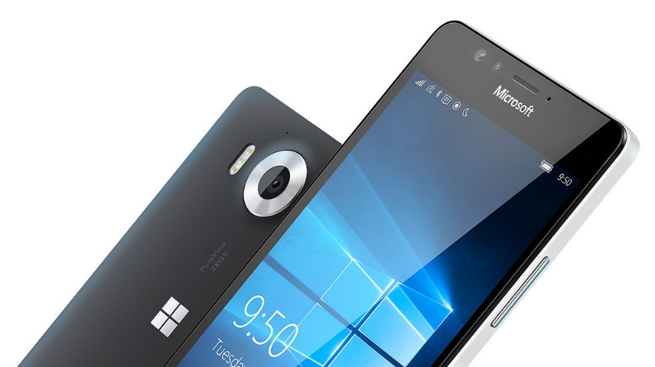
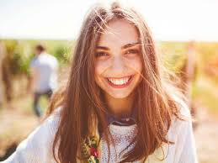
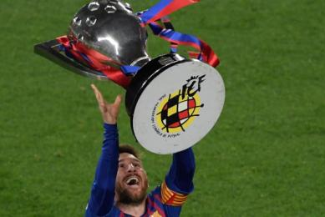
Mobile phone (11.6 W)
Annual consumption (16 hours per day) = 68 kWh
25 kg of CO₂
Teenager of 15/16 years: 2140-2700 kcal
(source FAO)
Daily consumption = 2.49-3.14 kWh
Annual consumption= 910-1150 kWh
Trip Tarragona-Camp Nou (source MITECO)
93 km
13.55 kg of CO₂ with gasolina engine
Weekly absorption of 37 trees

Slide 20
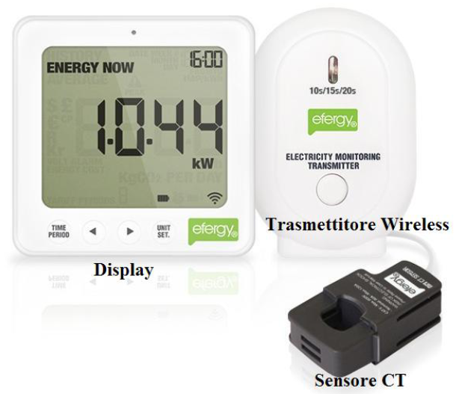
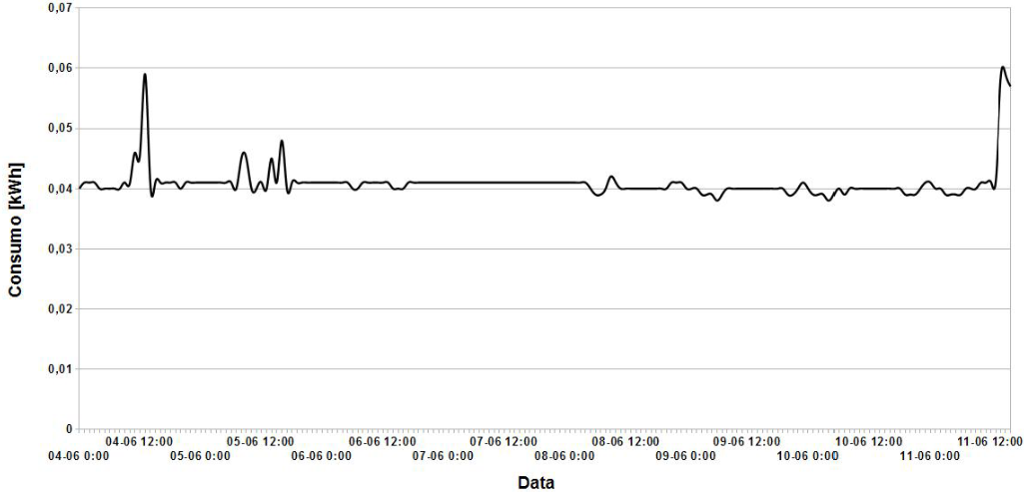
2015, Bachelor Thesis, Italy
We need to save energy!

Slide 21
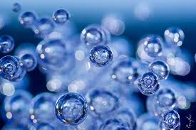

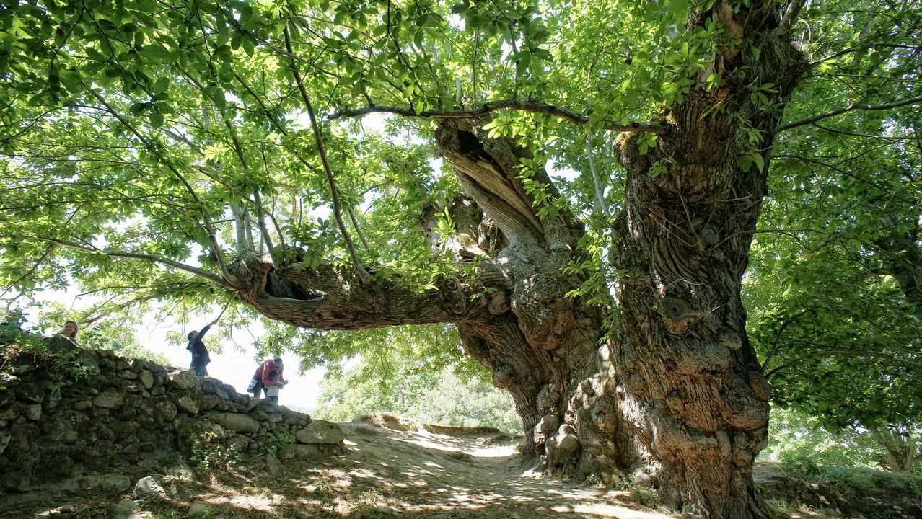
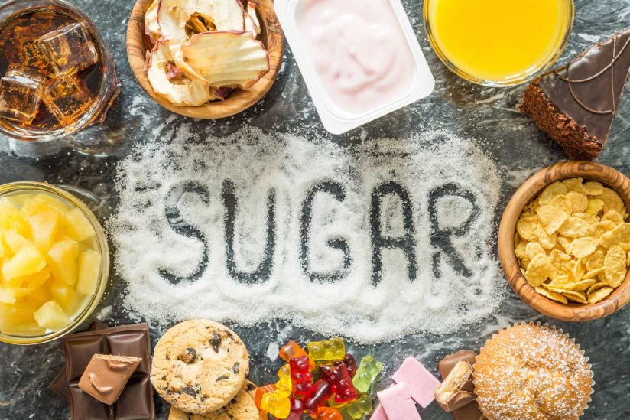

What about photosynthesis?
CO₂
O₂
Sunlight
Q5
1.3 kW/m²
Tree
Water
Energy storage
(sugars)

Slide 22
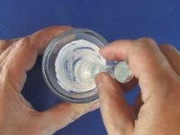
Dye-sensitized solar cells

Slide 23
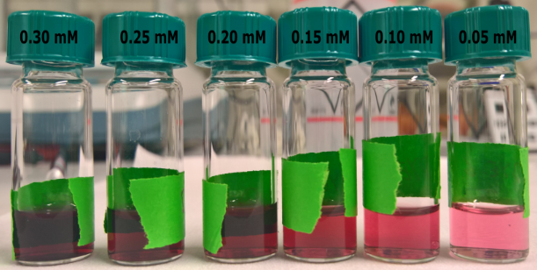
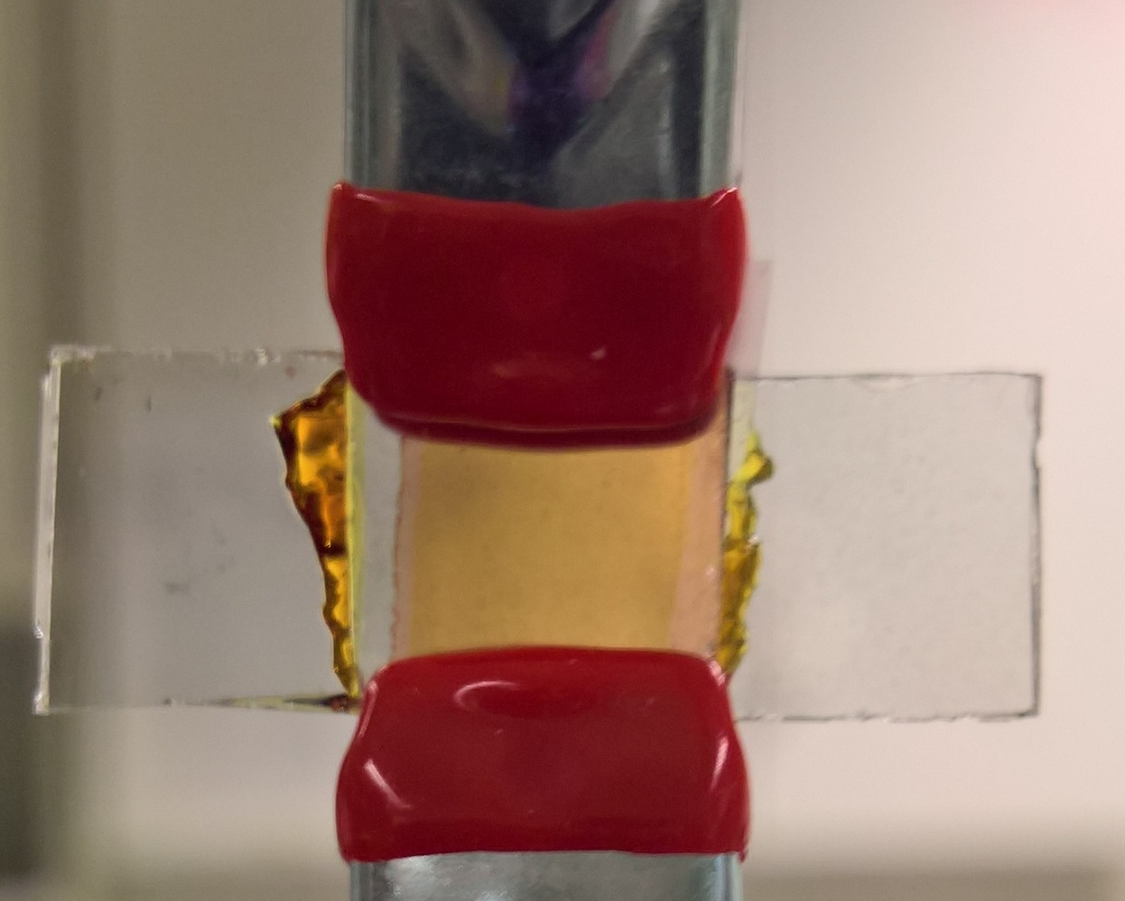
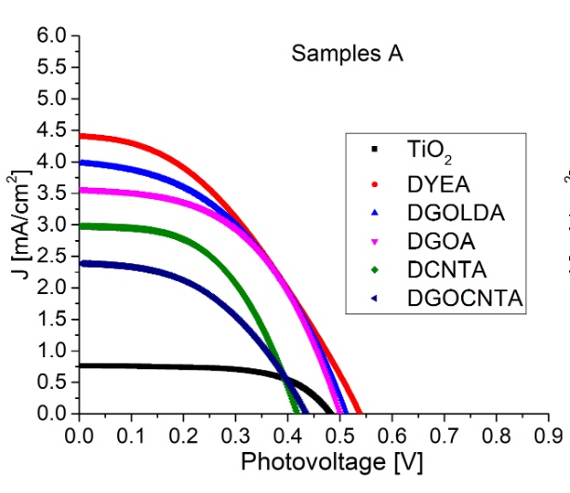
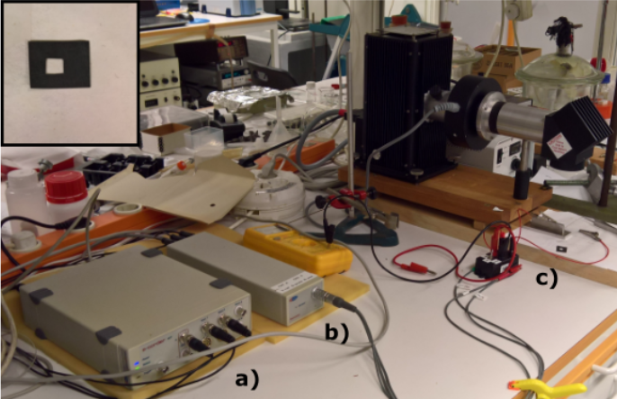
2017, Master Thesis, Sweden
Photoelectrochemistry is cooler!

Slide 24
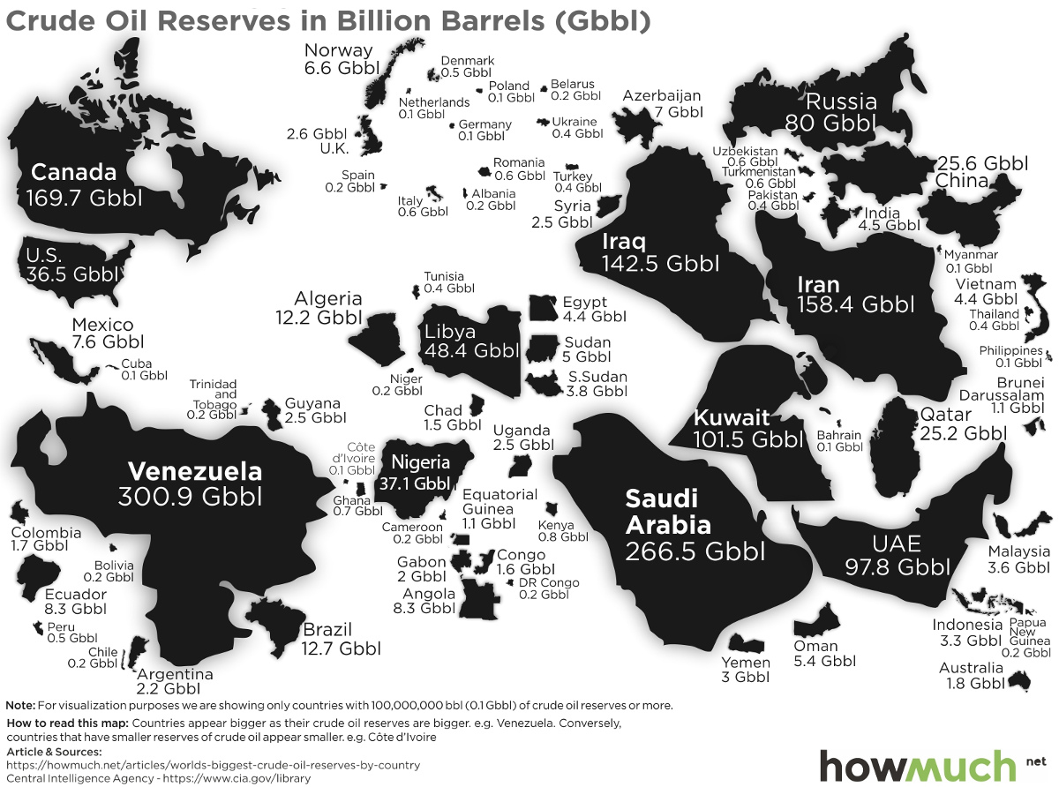
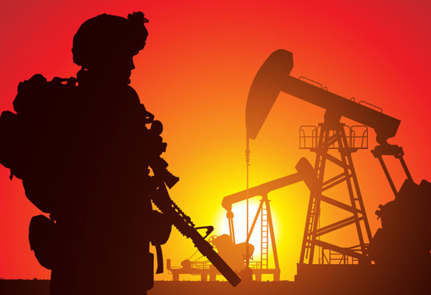
Organization of The Petroleum Exporting Countries (OPEC) https://www.visualcapitalist.com/

Slide 25


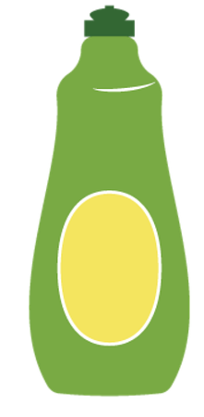
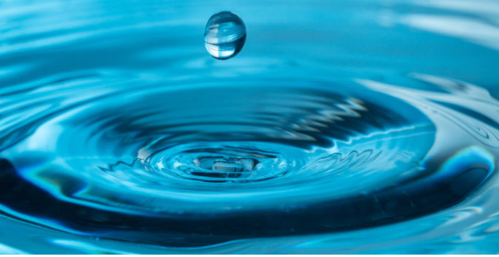
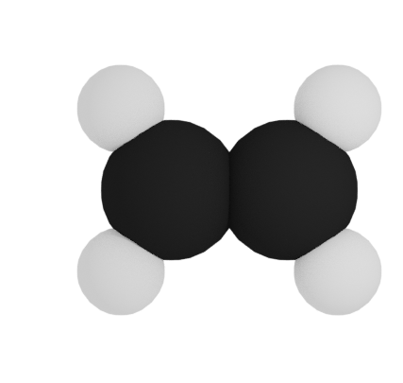

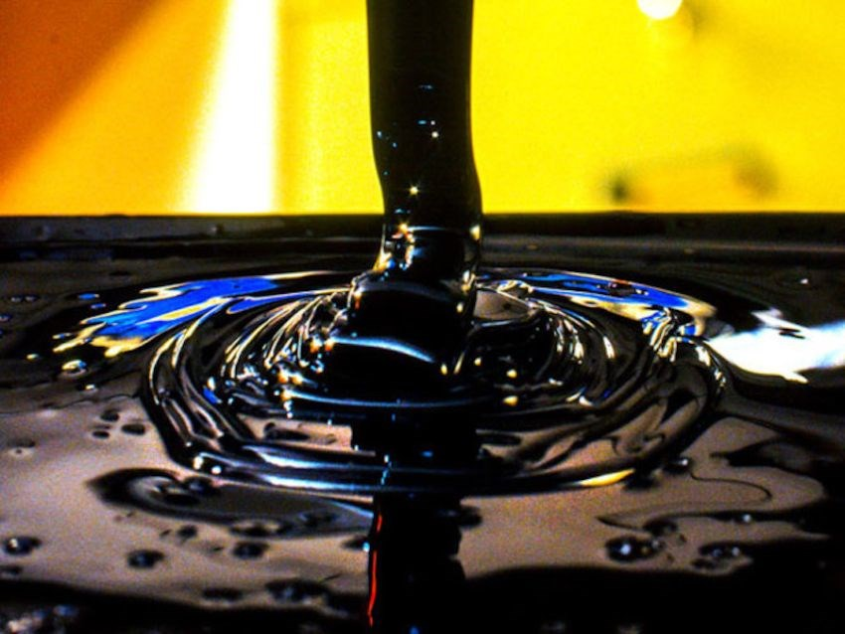


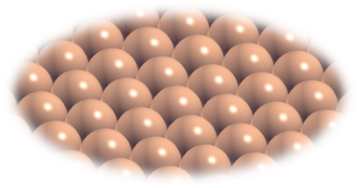
Energy storage through CO₂ reduction
CO₂
Water
Closing the carbon cycle
Renewable energy
Catalyst

Slide 26
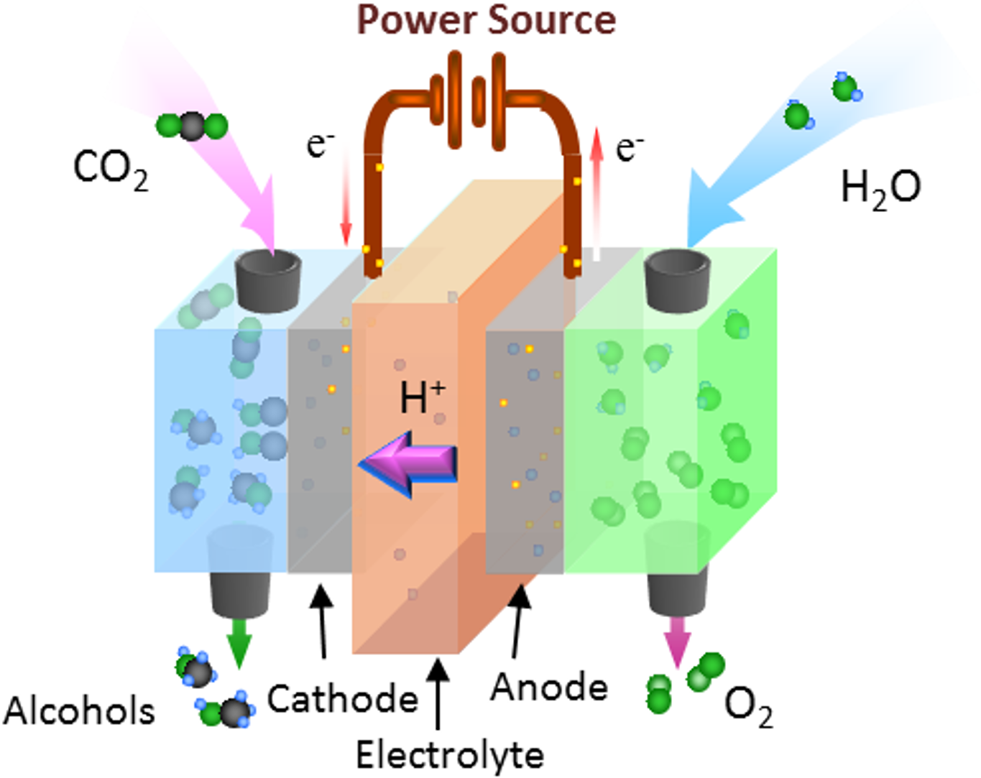
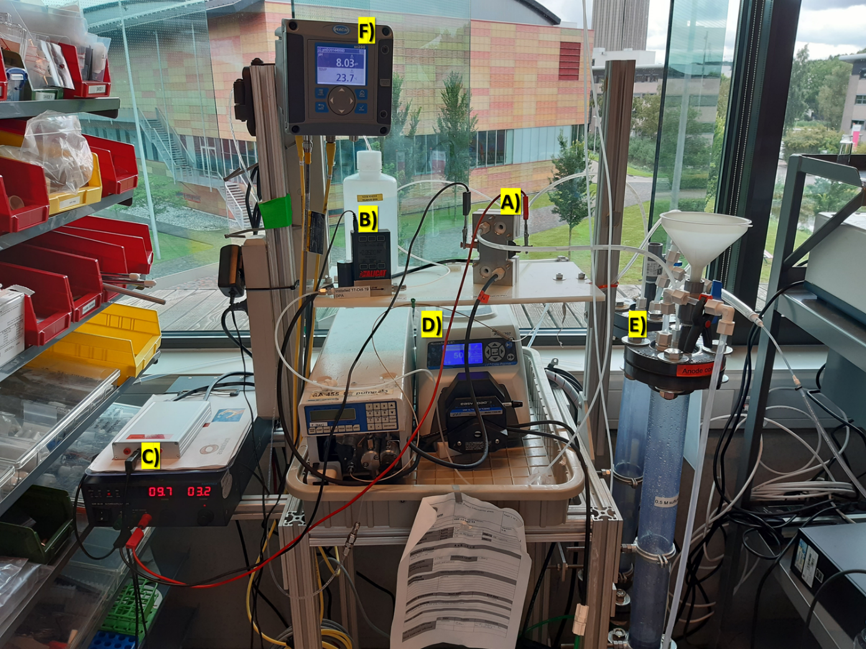

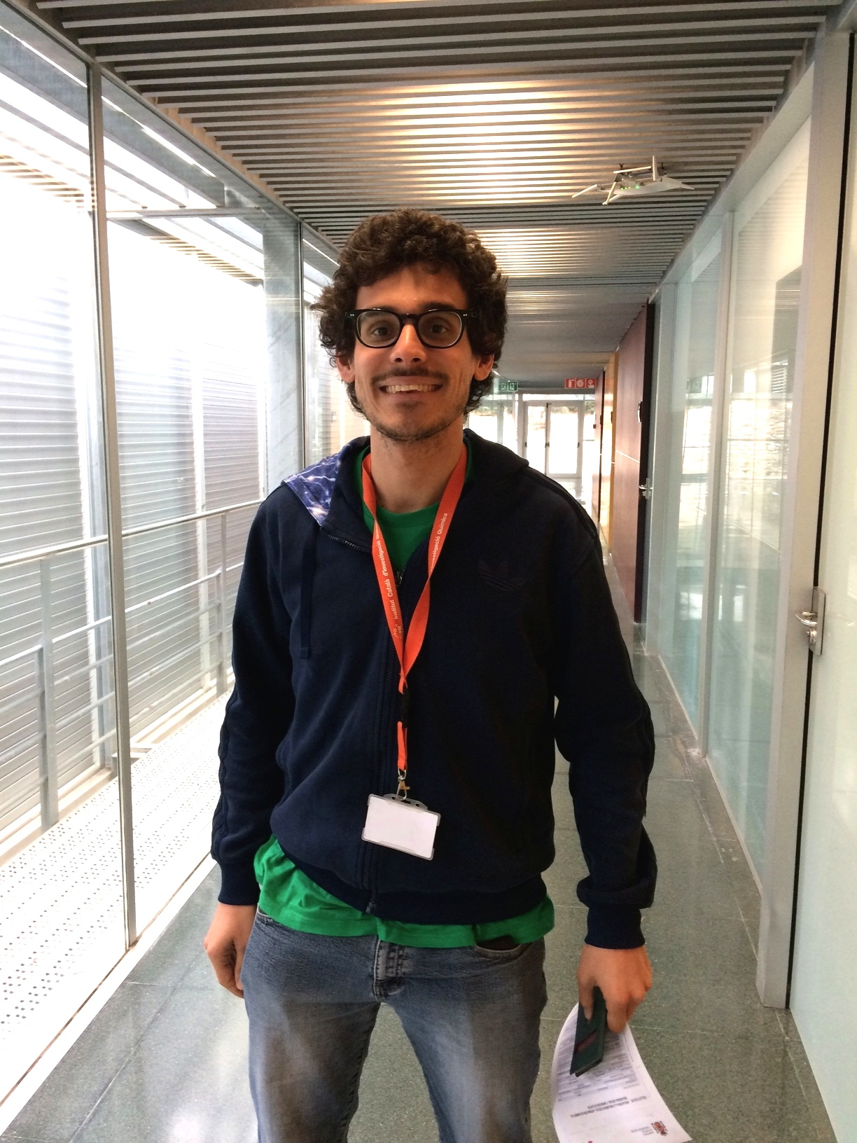

An electrochemical cell

Slide 27
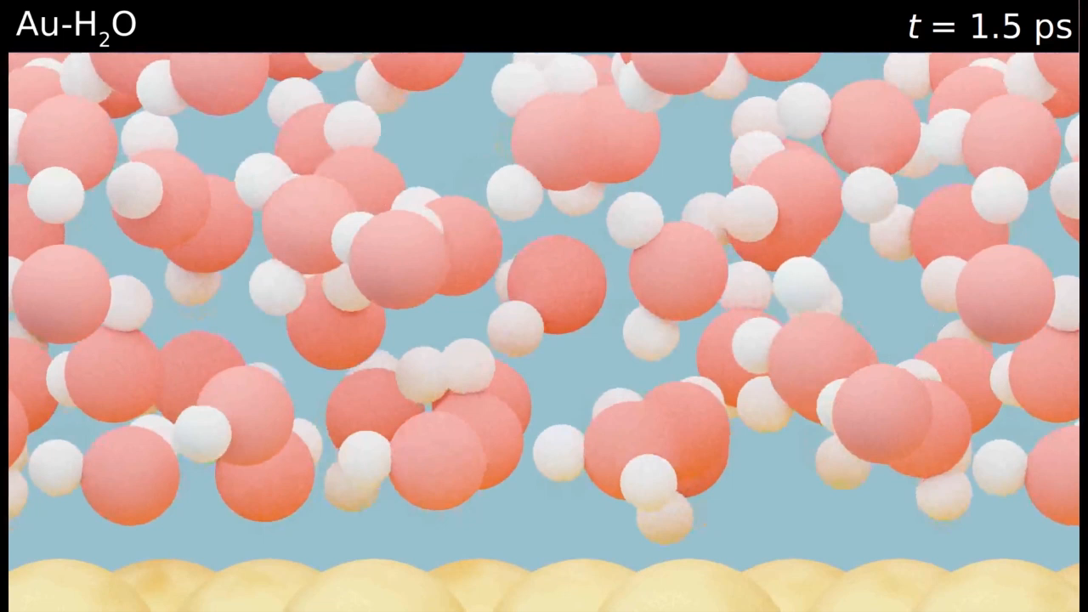
A closer look at the cathode
Catalyst

Slide 28
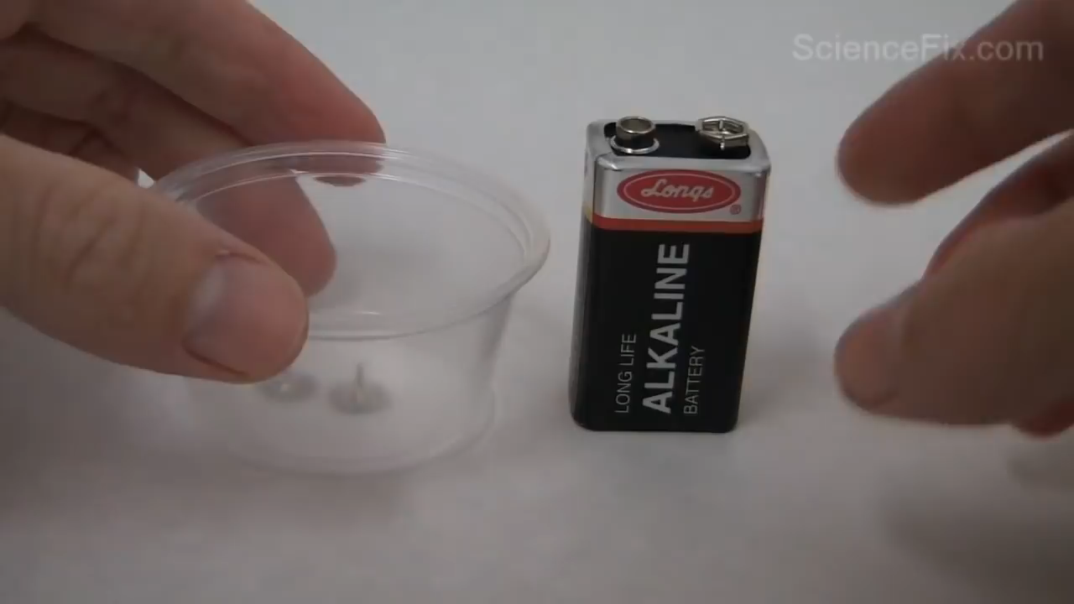
How does an electrochemical cell work?
Water Splitting: https://www.youtube.com/watch?v=HQ9Fhd7P_HA

Slide 29
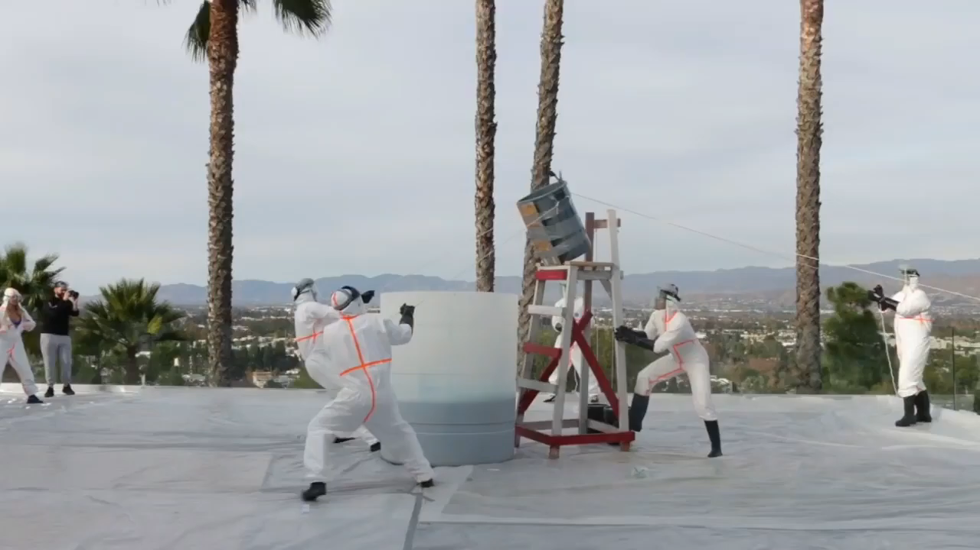
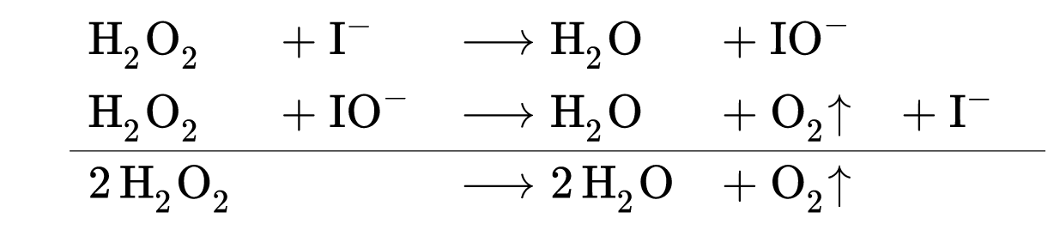
The “elephant toothpaste” reaction
Reagent
Product
I–
Catalyst
H₂O₂
https://www.youtube.com/watch?v=UamA1FWjHMw

Slide 30

Computational chemistry
Q6
How do you see a computational chemist?

Slide 31

Computational chemistry
How experimentalists see me…

Slide 32
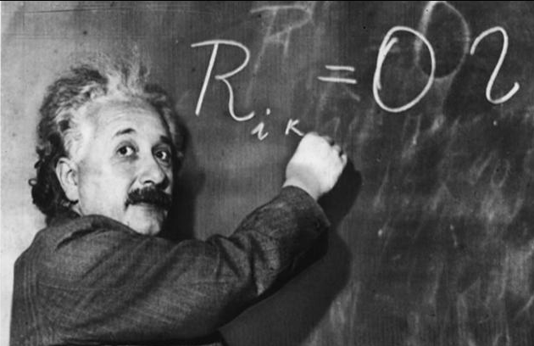
Computational chemistry
How I see myself…

Slide 33

Computational chemistry
The harsh reality

Slide 34

Quick responses to imput…
How does the weather look like tomorrow?

Slide 35

...still, models must be accurate!

Slide 36




My beloved models

Slide 37


How “big” is a molecule?
10⁻⁵ m
10⁻¹⁰ m
100000 atoms in a single hair!
4 10⁸ m
1.75 m

Slide 38


Eventually, it’s all about love...
CO₂
always bad love stories

Slide 39

…between CO₂ and electrons...
CO₂
always bad love stories
Its beloved electron

Slide 40

…thank to a good friend...
CO₂
always bad love stories
Copper, a good friend
Its beloved electron

Slide 41



…O no, the third wheel!
CO₂
always bad love stories
Copper, a good friend
Its beloved electron
Hydrogen, the third wheel

Slide 42

…even worst!
CO₂
always bad love stories
Copper, an ****
Its beloved electron
Hydrogen, the third wheel

Slide 43




From CO₂ to formate / formic acid

Slide 44


From CO₂ to CO

Slide 45


From CO to ethylene

Slide 46
Let’s be computational chemists!
Study of the state-of-the-art (4 groups, 15 minutes)
Desired reaction products
Promising catalysts
Study of the reaction pathway
Design of the electrolyte
General discussion (5 minutes each group)
Definition of the roadmap (5 minutes)
Preparation of input
Data analysis

Slide 47

Desired reaction products (group 1)
Chem 2018, 4, 1–16.

Slide 48


Promising catalysts (group 2)
ChemPhysChem 2017, 18, 3266–3273. ACS Catal. 2019, 9, 7894–7899.

Slide 49

Study of the reaction pathway (group 3)
J. Phys. Chem. Lett. 2015, 6, 4073–4082.

Slide 50


Design of the electrolyte (group 4)
Submitted ACS Catal. 2021, 11, 12336–12343.

Slide 51
Roadmap
Which product do we aim to?
CO (carbon monoxide)
Which catalyst should we then simulate?
Silver (Gold, Zinc)
Which CO₂ reduction pathway will occur?
CO2 -> CO2- -> COOH -> CO + H2O
Which cation should we employ?
Ba2+

Slide 52
Preparation of input (Bash)
Open your termux / termius app
Follow the steps

Slide 53
Data analysis (Python)
Open your python / pythonista app
Follow the steps

Slide 54






